Slide 1


Slide 2
The Lowdown
3D
“Chess with guns”
Cooldown based
Multiplayer (PvP)

Slide 3
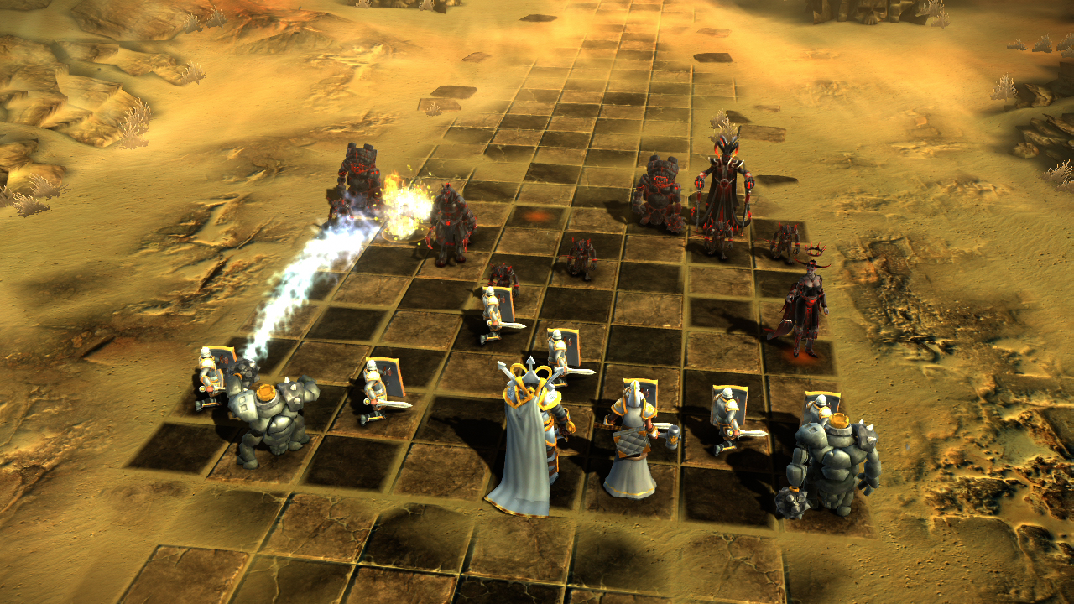
Notes:
Inspiration: battle chess

Slide 4
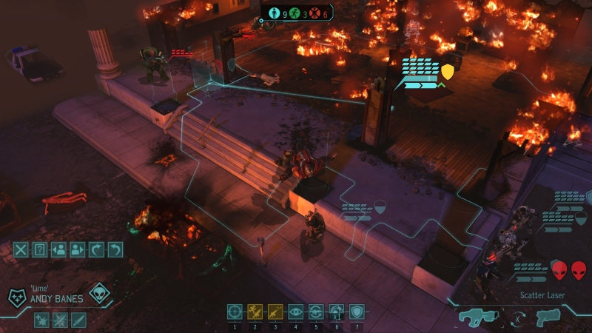
Notes:
Inspiration: XCOM

Slide 5
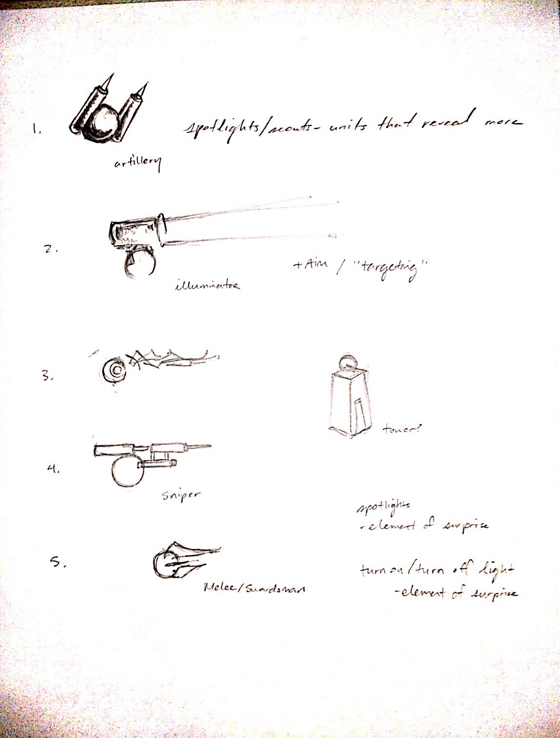
Features
Units with different classes
Fog of war
Line of sight

Slide 6
Art style
Notes:
Game ideas

Slide 7


Slide 8
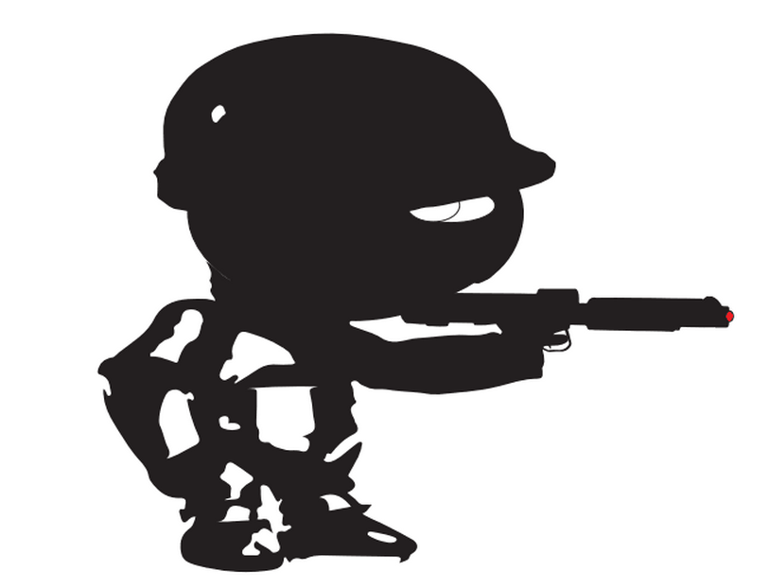
Notes:
Concept art goes here

Slide 9


Slide 10


Networking
Node.js: client – server communication
Host on Nodejitsu

Slide 11
Roles
Peter Chang, Matt Zhao – game architecture, game logic
WenXuan Cai - networking
Matt Kerkstra – game art

Slide 12
Notes:
Demo time

